Slide 1
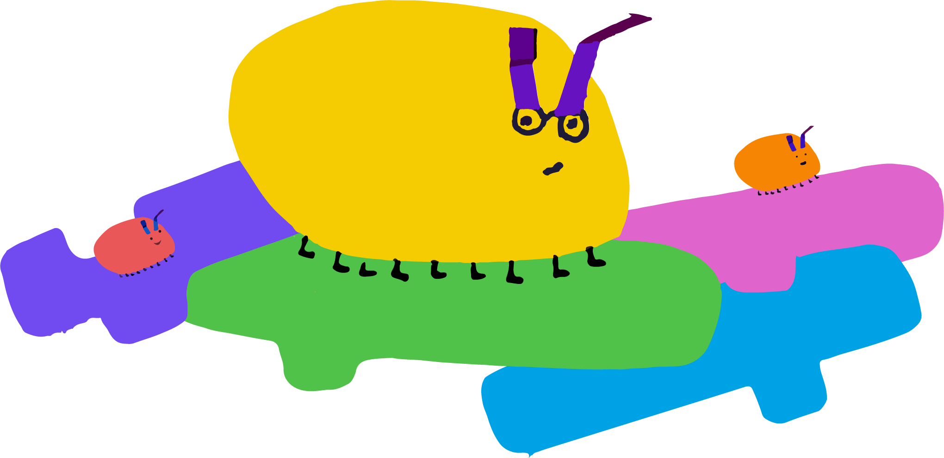
Parallelism
What is this?
Parallelism is one of 10 modules in Getting Unstuck, a Scratch curriculum developed by the Creative Computing Lab. The aim of the curriculum is to foster classroom cultures that support creative and conceptual fluency with code.
What’s inside?
For the teacher
Prompt overview
Activities overview
Teaching the module
For the student
Design journal cover page
Foundational activities
Additional activities
Find more modules and the orientation to Getting Unstuck at gettingunstuck.gse.harvard.edu

Slide 2
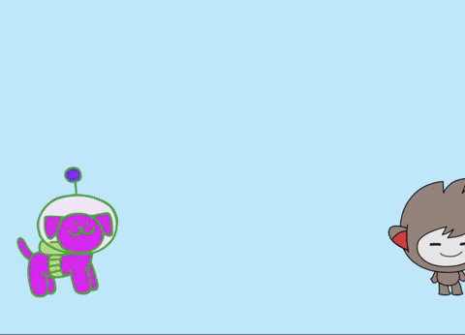
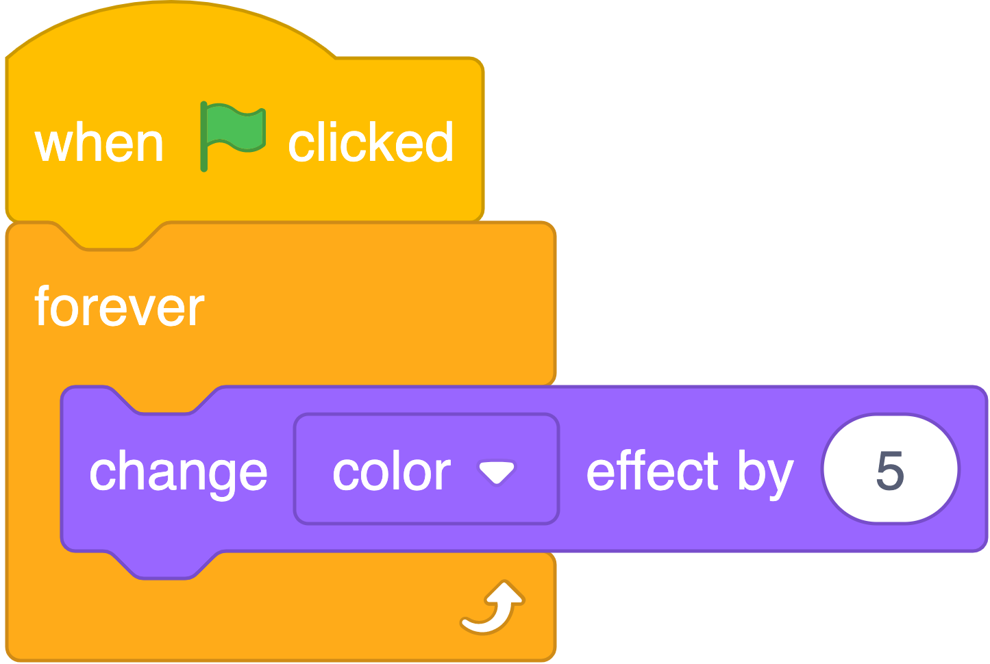
Prompt Overview - Parellelism
Create a project that uses multiple green flag blocks to make things happen at the same time.
What concept will we explore in this module?
In this module, students use the when green flag clicked block to explore the concept of parallelism: making two or more things happen at the same time.
The code stack on the left is on the dog. The code stack on the right is on Nano. When the green flag is clicked, both sprites begin their actions simultaneously.

Slide 3
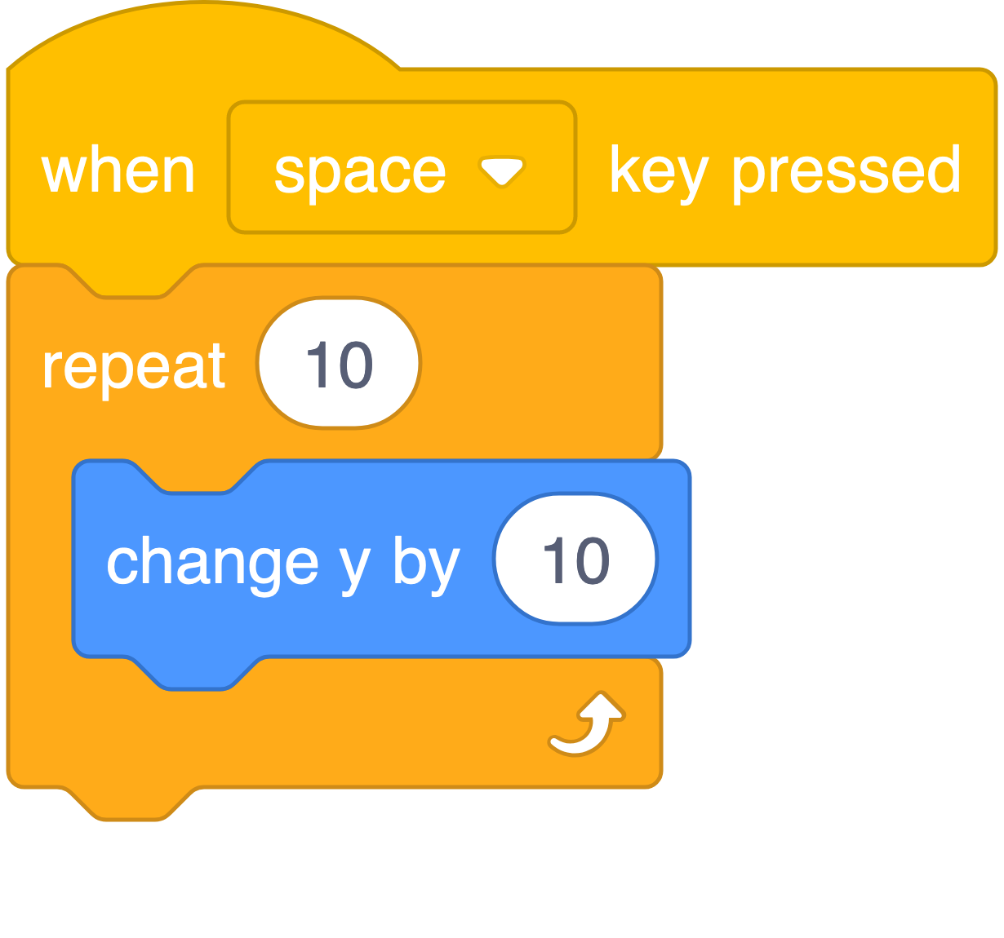
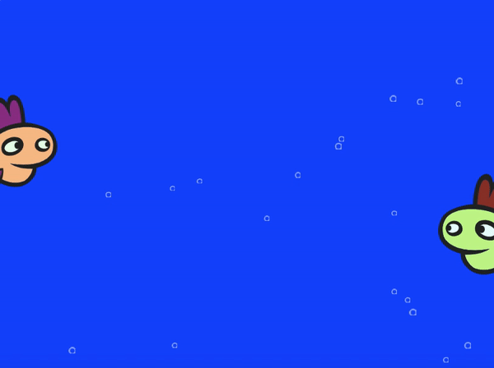
What can students make with parallelism?
In Scratch, parallelism can mean two or more code stacks running on the same sprite at the same time, causing the sprite to do multiple things simultaneously. Parallelism can also mean two or more code stacks running on different sprites at the same time, causing multiple sprites to do things simultaneously.
To encourage students to explore parallelism, this module asks students to create projects where multiple when green flag clicked blocks are used to make things happen simultaneously. This could mean multiple sprites doing different dance moves, having a conversation, or something else entirely! It could also mean background music or animation on the stage while a sprite performs some activity in the foreground.
If a player presses the spacebar, this code stack causes the sprite to jump. Pressing space to jump can cause the sprite to avoid obstacles.
What else should I know about parallelism?
Parallelism can expand students’ understandings of what is possible in Scratch. Talking to students about parallelism can encourage students who tend to be finished quickly to explore new concepts and ideas. For example, you could encourage students to add another sprite to their project and program that sprite to interact with existing project elements in new ways.

Slide 4
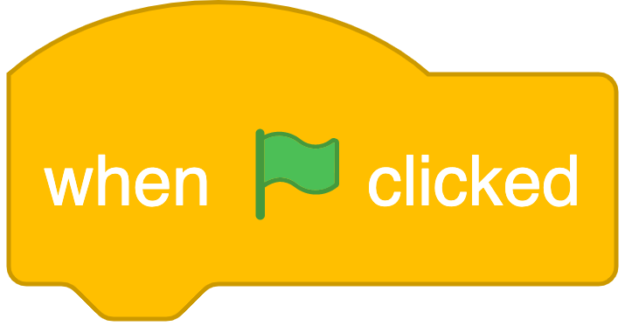
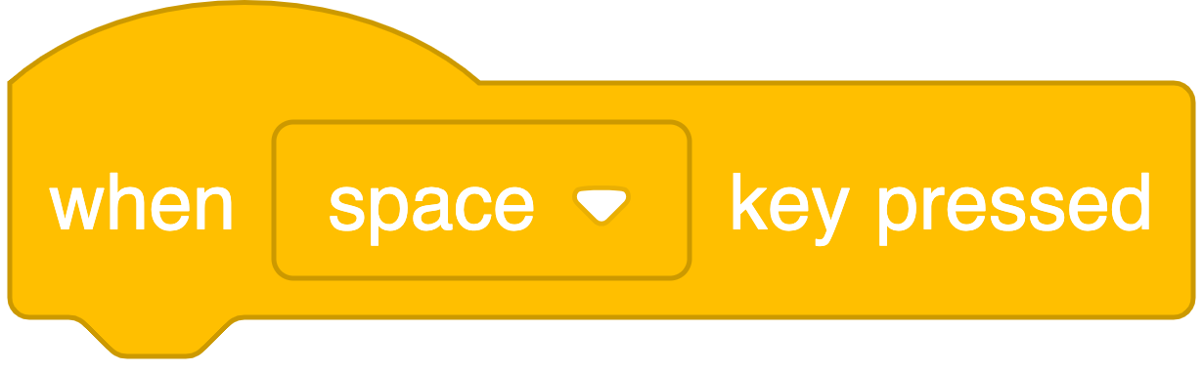
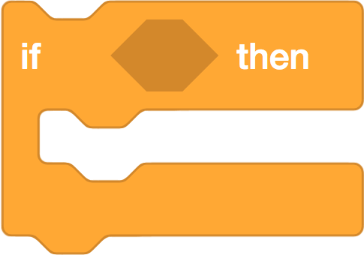
There are many different ways to go about creating this project. Here are a few blocks that students might use:
 | This event block runs a code stack when the green flag (in the top corner of the project) is clicked. This block is almost always used to start a project in Scratch. If students are having trouble “restarting” their projects (e.g., their sprite has walked to the edge of the screen but has not returned to the original position), it can be useful to add some when green flag clicked code stacks to reset the project.
 | This event block causes a sprite to run a code stack when a specific key is pressed. The drop-down menu can be used to select the specific key.
 | The if/then block is a conditional control block. This block checks if the condition inside is true, and if so, runs a nested code stack. This block needs an event block to run it, and will also need a hexagon-shaped block (such as a sensing block or Boolean operator block) to provide the condition.
Additional resources
Animate a Character: Explore this educator guide (pp. 9–12) to familiarize yourself with ways to support students in animating their sprites
Getting Unstuck 2020 Studio: Explore additional Parallelism projects made by teachers

Slide 5
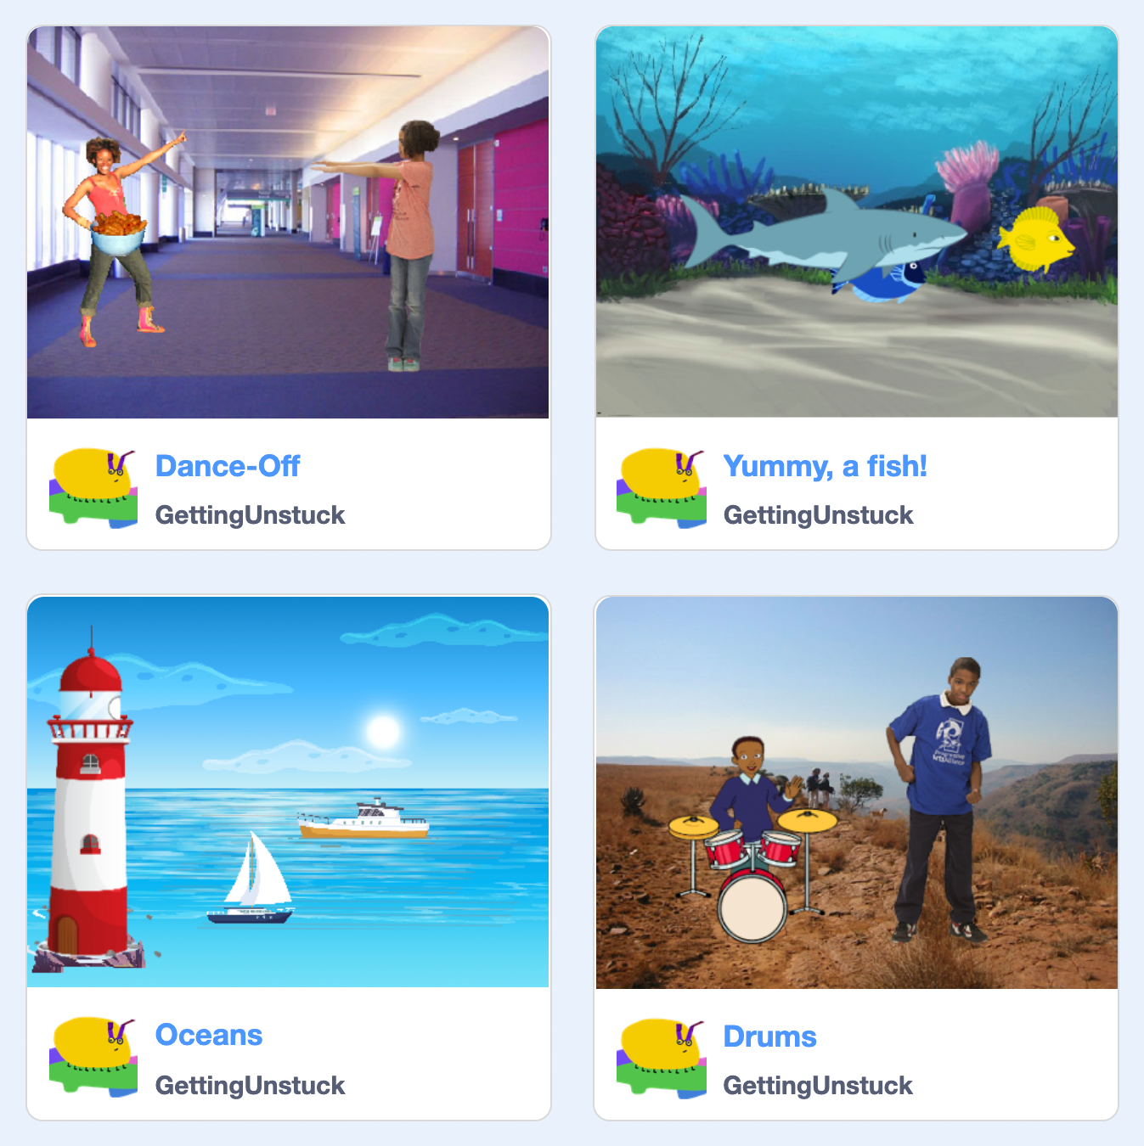
 | Inspiration Studio | Name
 |  | Username
Explore
Exploring projects that other Scratchers have made can help us get inspired about what we want to make!
Click on this link: scratch.mit.edu/studios/27321000
Visit a few of the projects in the Parallelism studio. Choose a project that you think is interesting.
Why is this project interesting to you?
Open that project and click
Find two when green flag clicked blocks and look at their code stacks to see what happens.
What are two things that happen when the green flag is clicked?

Slide 6
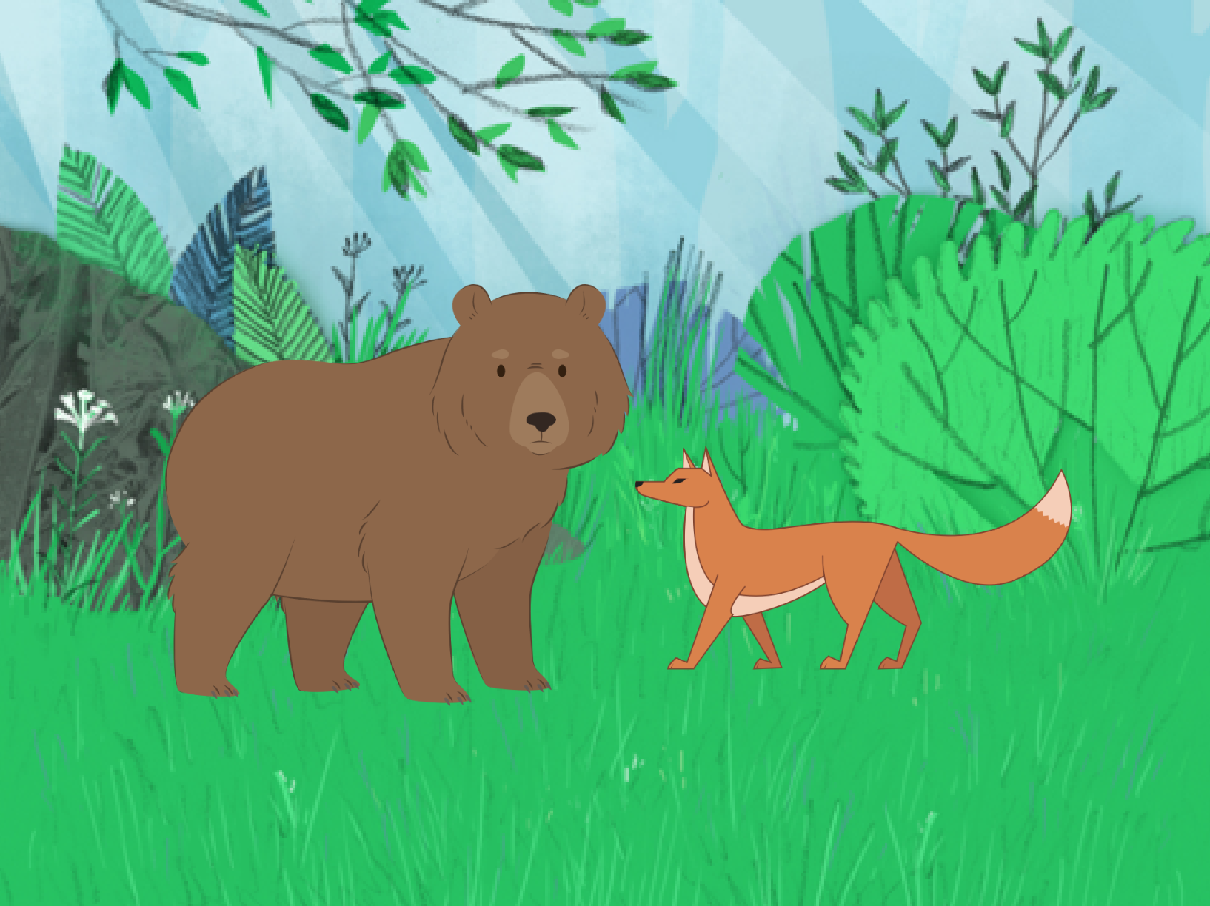
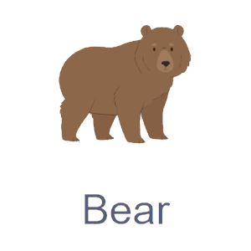
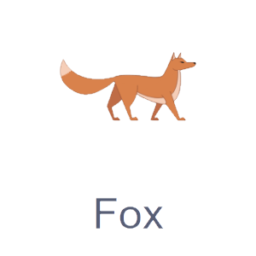
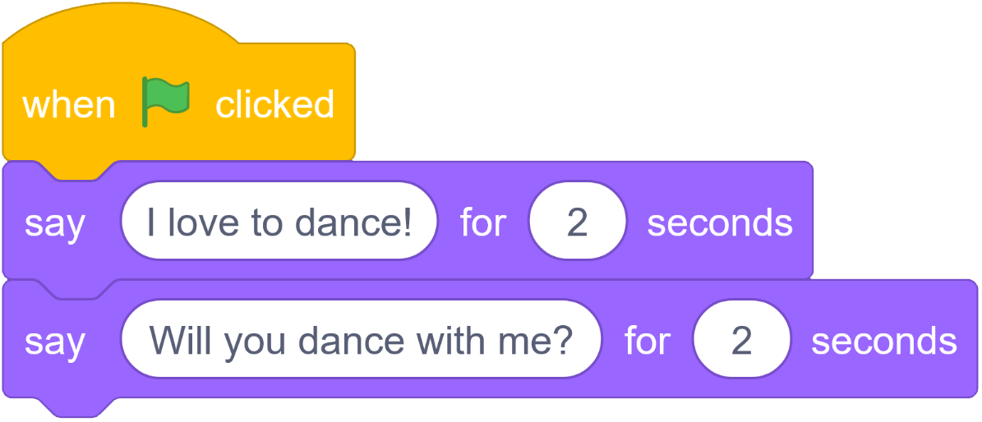
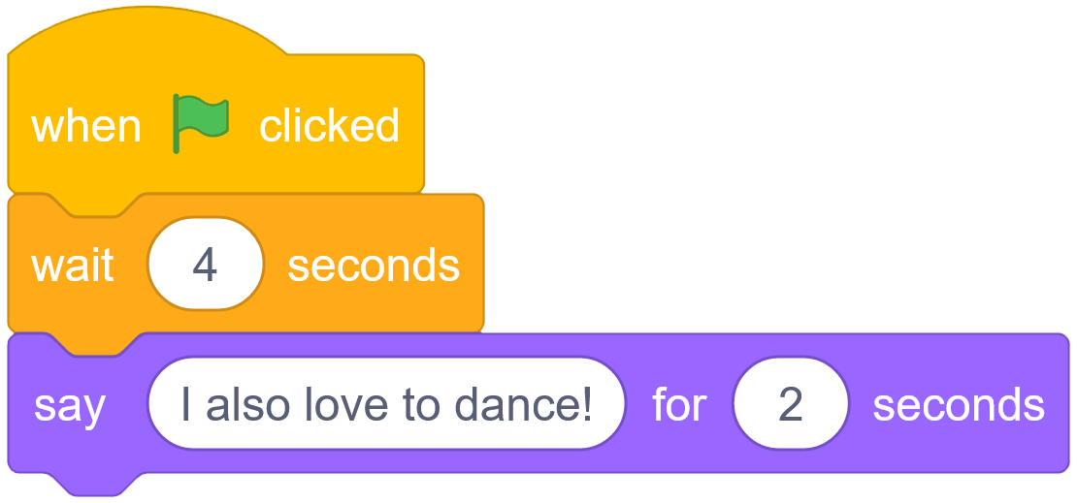
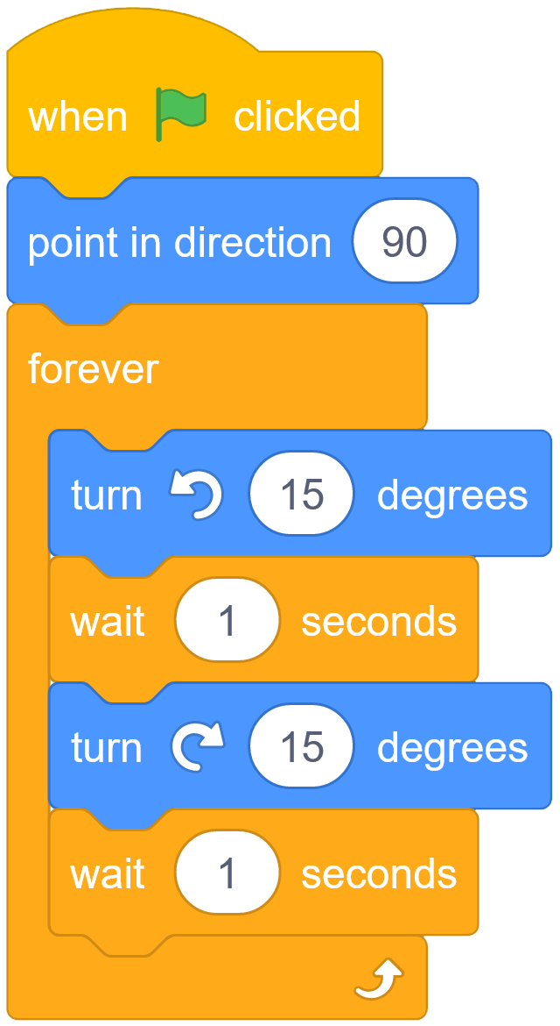
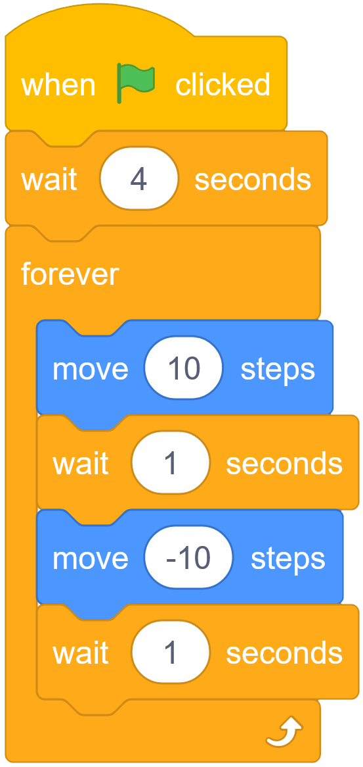
 | Read Me | Name
 |  | Username
Explore
Read the code for this Parallelism project. What happens in this project?

Slide 7
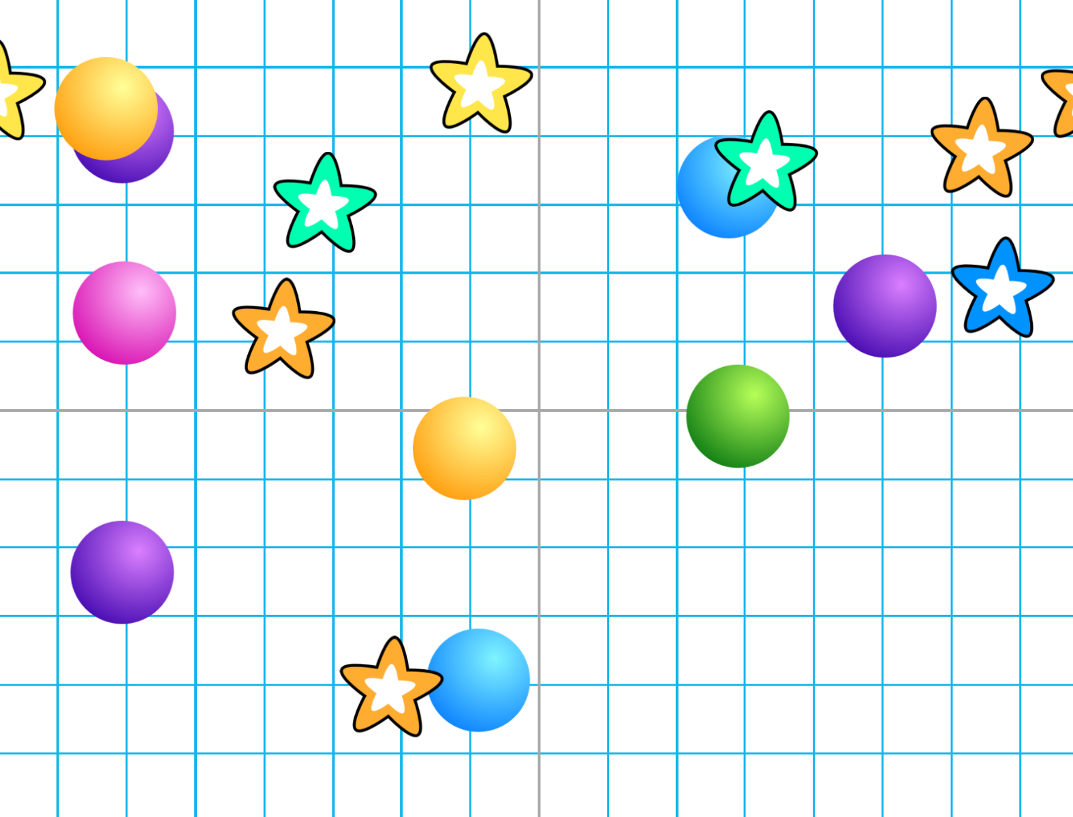
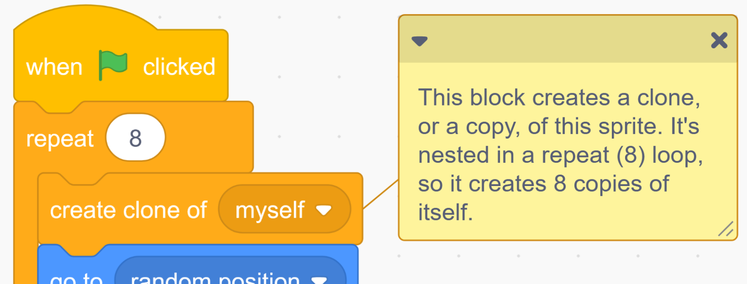
 | Remixable | Name
 |  | Username
Create
Go to the Remixable for Parallelism at scratch.mit.edu/projects/542032331
Read the instructions and notes.
Try out the project! What do you notice?
Click to explore the code.
Click to create a remix.
What are 3 things you could change in this project to make it your own?

